Slide 1
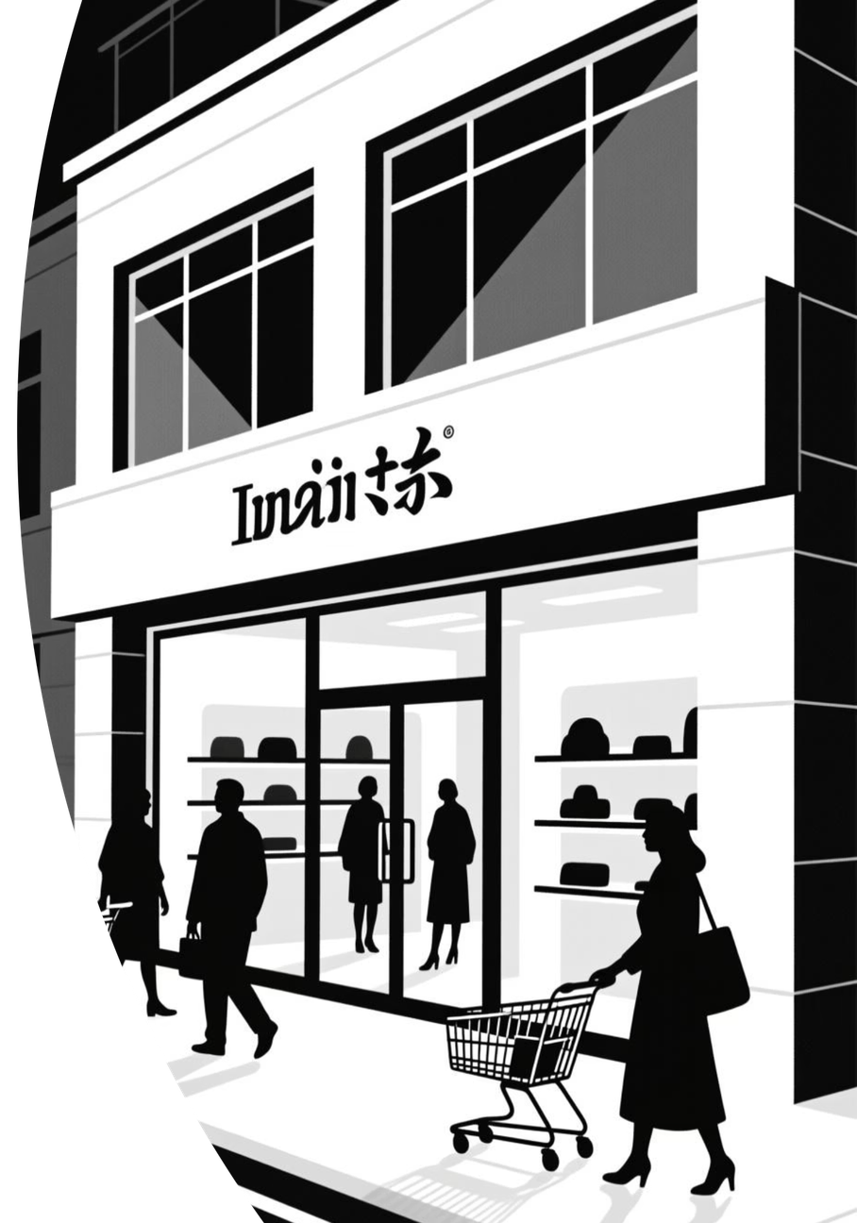

D-Mart Business Performance Analysis 2021-2023
Strategic insights and growth opportunities for Senior Management
Notes:
1

Slide 2
About This Analysis
This presentation examines D-Mart's comprehensive business performance across 2021-2023, analysing key metrics including revenue trends, geographic distribution, customer behaviour, and product performance. Our objective is to identify strategic growth opportunities and provide actionable recommendations to drive the next phase of expansion.
01
02
Performance Review
Geographic Insights
Comprehensive analysis of core business metrics
Regional opportunities and expansion potential
03
04
Customer & Product
Strategic Actions
Experience optimisation and top performers
Data-driven recommendations for growth
Notes:
2

Slide 3

Key Performance Highlights
Strong foundation across all major business metrics demonstrates D-Mart's market positioning and customer reach.
₹17M
25K
1M
Total Revenue
Product Range
Customer Clicks
Cumulative revenue across three-year period
Diverse catalogue serving customer needs
Strong digital engagement and traffic
Notes:
3

Slide 4



Geographic Opportunities: Top Performing Cities
Leading Markets
Our top three cities demonstrate exceptional performance, collectively driving significant order volumes. These markets represent our strongest customer bases with established brand loyalty and efficient operations.
City #1
Strategic Focus: Continue investment in these regions whilst leveraging their success patterns for expansion strategies.
Highest order volume and consistent growth trajectory
City #2
Strong market penetration with loyal customer base
City #3
Emerging market with rapid expansion potential
Notes:
4

Slide 5
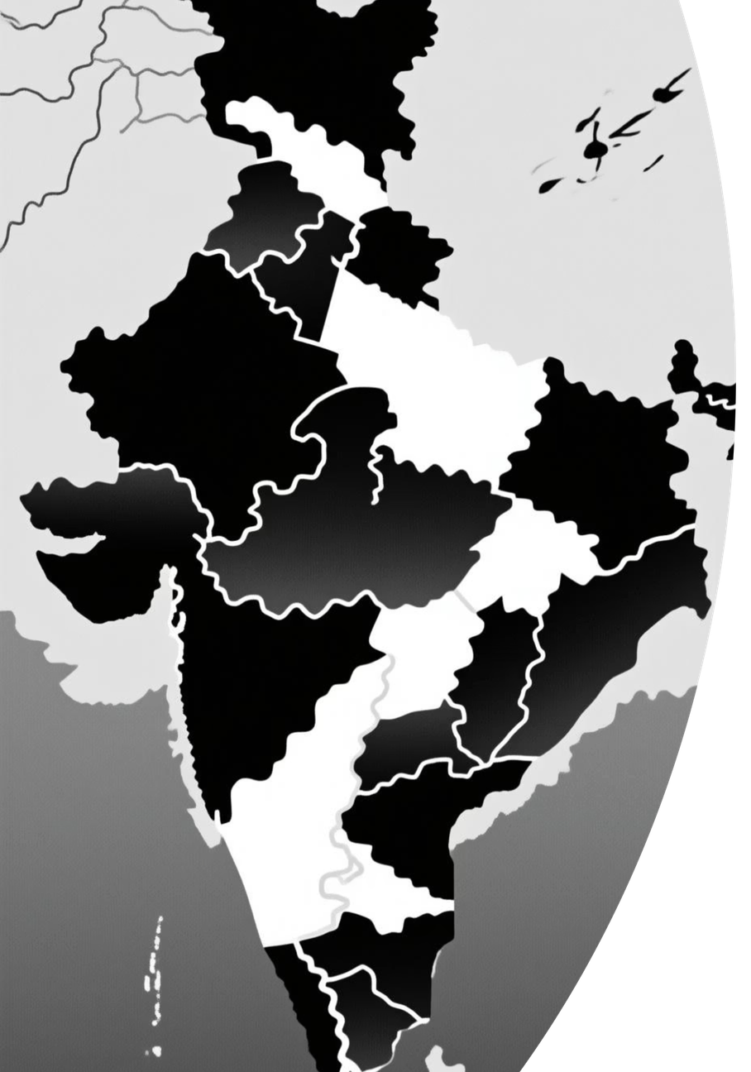
Untapped Regional Potential
Tier-2 City Expansion
Geographic data reveals underperforming regions with significant population density. These markets show lower order volumes despite strong demographic profiles, presenting immediate expansion opportunities.
Distribution Network Gaps
Analysis indicates logistics and supply chain limitations in certain zones. Strengthening infrastructure in these areas could unlock substantial revenue growth whilst improving delivery times.
Notes:
5

Slide 6



Customer Experience: Rating Analysis
Understanding customer satisfaction drivers to enhance service quality and product offerings.
85%
12%
3%
Positive Ratings
Neutral Ratings
Negative Ratings
4-5 star reviews indicating strong satisfaction
3-star reviews showing room for improvement
1-2 star reviews requiring immediate attention
Key Insights
Improvement Areas
Strong overall satisfaction with 85% positive ratings
Enhance packaging to reduce transit damage
Neutral ratings often cite delivery delays
Implement faster resolution for complaints
Product quality remains consistent strength
Expand product information and descriptions
Notes:
6

Slide 7
Top 5 Product Performers
Perle Nutricrunch
Digestive Cookies
Product #3
Leading product with consistent sales across all regions
Strong repeat purchase rate and customer loyalty
Emerging category with high growth potential
Product #4
Product #5
Seasonal favourite with predictable demand patterns
Premium offering with excellent margins
Strategic Recommendation: Expand product variants within these successful categories and leverage their brand equity to introduce complementary items.
Notes:
7

Slide 8
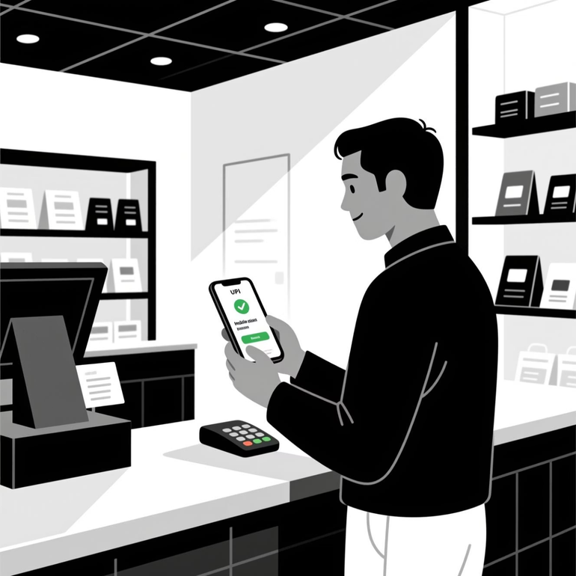
Transaction & Payment Trends
Digital Payment Dominance
UPI has emerged as the preferred payment method, reflecting India's digital payment revolution. This shift presents opportunities for seamless checkout experiences and reduced transaction costs.
Payment Method Distribution
UPI: 58% of all transactions
Credit/Debit Cards: 28% of transactions
Cash on Delivery: 14% of transactions
The declining COD trend indicates growing customer trust and digital adoption. Continue optimising digital payment infrastructure.
Notes:
8

Slide 9

Order Patterns by Day of Week
1
Weekend Surge
Saturday and Sunday show 40% higher order volumes compared to weekdays, indicating leisure shopping behaviour and family purchasing patterns.
2
Mid-Week Consistency
Tuesday through Thursday demonstrate steady baseline orders, representing routine household purchases and planned shopping.
3
Monday Dip
Lowest order day reflects post-weekend patterns. Opportunity for targeted promotions and incentives to boost early-week sales.
Notes:
9

Slide 10



Strategic Recommendations
Three actionable priorities to drive 10% revenue growth in the next fiscal year.
Product Portfolio Optimisation
Customer Experience Enhancement
Expand variants of top 5 products and introduce complementary items. Leverage successful brand equity whilst testing new categories in strong markets. Expected impact: 3% revenue growth.
Geographic Expansion
Launch operations in identified underperforming regions with high demographic potential. Prioritise tier-2 cities with improved logistics infrastructure. Expected impact: 4% revenue increase.
Address neutral ratings through packaging improvements and faster complaint resolution. Implement enhanced product descriptions and photography. Expected impact: 3% conversion improvement.
ThankYou
Notes:
10

